Slide 1
Computational Methods for Computer Science
Topic 2: Number theory

Slide 2
Why Number Theory?
Godfrey Harold Hardy (b. 1877. d. 1947)
– a prominent British mathematician
– great achievements in number theory and mathematical analysis
In his 1940 autobiography “A Mathematician’s Apology”, Hardy wrote
”The great modern achievements of applied mathematics have been in
relativity and quantum mechanics, and these subjects are, at present,
almost as ‘useless’ as the theory of numbers.”
”... then the great bulk of higher mathematics is useless. Modern
Geometry and algebra, the theory of numbers, the theory of aggregates
and functions, relativity, quantum mechanics – no one of them stands
the test much better than another, . . .”
However, number theory has become the basis of modern coding theory. Computer security and e-commerce would be impossible without it.

Slide 3
Brief Intro to Cryptography – Terminology
Sender, Receiver and Eavesdroppers
Eavesdroppers are assumed to have complete access to the communications between the sender and receiver.
Messages and Encryption
Plaintext decryption or decipher
Cipher text encryption or encipher
Cryptography – keeping messages secure
Cryptographers
Cryptanalysis – breaking cipher text
Cryptanalysts
Cryptology – both cryptography and cryptanalysis
Cryptologists
generally trained in theoretical mathematics

Slide 4
Brief Intro to Cryptography – Terminology
Jobs of Cryptography
Confidentiality – hiding messages
Authentication – ascertain message origin
Integrity – message hasn’t been altered
Nonrepudiation – message sender cannot say “I did not send it”
Algorithms and Keys
Cryptographic algorithm – also called “cipher”, functions for encryption and decryption
Restricted algorithm – algorithm itself kept secret
Modern Cryptography – relies on a “key” with value from a key space while algorithm is public.

Slide 5
Brief Intro to Cryptography – Terminology
Symmetric Algorithms – also called conventional algorithms
Encryption key can be calculated from the decryption key and vice versa. In most cases, they are the same.
Stream Algorithms or stream ciphers – bits or bytes
Block algorithms or block ciphers – typically 64 bits
Public-Key Algorithms – also called asymmetric algorithms
Encryption Key – public
Decryption Key – private, can not be calculated from public key
Digital Signature – encrypt with private key, decrypt with public key

Slide 6
Brief Intro to Cryptography – Terminology
Cryptanalysis – science of recovering the plaintext of a message without access to the key
cryptanalyst has complete details of the cryptographic algorithm and implementation – a reasonable assumption
secrecy must reside entirely in the key
Compromise – loss of a key through non-cryptanalytic means
Attack – an attempted cryptanalysis

Slide 7
Modular Arithmetic
Definition (1st version);
Let m, n be positive integers. Then m mod n is the remainder left when dividing m by n.
Ex: 25 mod 4 = 1; 25 mod 5 = 0; 27 mod 5 = 2.
Definition (2nd version);
For an integer m and positive integer n, m mod n is the smallest nonnegative integer r such that, for some integer q, m = nq + r.
Ex: 25 mod 4 = 1; −25 mod 4 = 3.

Slide 8
Modular Arithmetic
Lemma 1.
i mod n = (i + kn) mod n for all integers k.
Lemma 2.
(i + j) mod n = (i + (j mod n)) mod n
= ((i mod n) + j) mod n
= ((i mod n) + (j mod n)) mod n,
(i · j) mod n = (i · (j mod n)) mod n
= ((i mod n) · j) mod n
= ((i mod n) · (j mod n)) mod n.
Don’t assume: [(ab) mod n] = [(a mod n) · (b mod n)]
[(a + b) mod n] = [(a mod n) + (b mod n)]

Slide 9
Modular Arithmetic
Definition:
Z_{n} is the set of integers {0, 1, . . . , n − 1} with
addition modn i +_{n} j = (i + j) mod n and
multiplication modn i ·_{n} j = (i · j) mod n
If x, y ϵ Z_{n}, we use x +_{n} y and x ·_{n} y to perform algebraic operations on x, y.
Multiplicative identity property: 1 ·_{n} i = i.
Additive identity property: 0 +_{n} i = i.
a −_{n} b denotes a +_{n} (−b).

Slide 10
Modular Arithmetic
Example: n = 7. Z₇ = {0, 1, 2, 3, 4, 5, 6}
Addition: i +₇ j Multiplication: I ·₇ j

Slide 11
Modular Arithmetic
Theorem 1
Addition and multiplication modn satisfy the commutative, associative and distributive laws.
a +_{n} b = b +_{n} a
a · _{n} b = b · _{n} a
a +_{n} (b +_{n} c) = (a +_{n} b) +_{n} c
a · _{n} (b · _{n} c) = (a · _{n} b) · _{n} c
a · _{n} (b + _{n} c) = (a · _{n} b) + _{n} (a · _{n} c)

Slide 12
Private-Key Cryptography using +_{n}
Sender and receiver agree in advance on a secret code and then send messages using that code.
Caesar cipher: A private-key cryptosystem in which letters of the alphabet are shifted (circularly) by some fixed amount. Easy to implement using arithmetic mod 26.
(Use 0 for A, 1 for B, . . .., denoted as n)
A Caesar cipher with shift s can easily be implemented on most computers by replacing each “letter” n with n’ = (n + s) mod 26.

Slide 13
Private-Key Cryptography using +_{n}
How should the receiver decipher (decrypt) the message?
Easy: Replace n’ by (n’ − s) mod 26,
E.G. If s = 4, then a received 22 8 4 (WIE)
becomes 18 4 0 which is SEA.
A slightly different view Inverse Function
the encryption function is E_{k}(x) = x +₂₆ k D_{k}(x) = E_{k}(x)
the decryption function is D_{k}(y) = y −₂₆ k x = D_{k} (E_{k}(x))
Key Space?
₋₁

Slide 14
Private-Key Cryptography using · _{n}
Private key is some a, n.
Encrypt: E_{a,n}(x) = a ·x mod n = a ·_{n} x
Decrypt: “Divide” E(x) by a mod n.
Goal:
D_{a,n}(E_{a,n}(X)) = X where D_{a,n}(X) = a⁻¹ ·_{n} X
Questions:
What exactly does division modn mean?
Does division exist for all the element in Z_{n}?

Slide 15
Private-Key Cryptography using · _{n}
E(x) = a · _{n} x
(a, x, n) = (4, 3, 12):
Recipient receives E(3) = 4 · ₁₂ 3 = 0.
Problem: There are 4 values of x,
(0, 3, 6, 9), s. t. 4 ·₁₂ x = 0.
Recipient doesn’t know which x you intended.
➔ E⁻¹ doesn’t exist!
Impossible to decrypt!
Don’t let the recipient guess!

Slide 16
Private-Key Cryptography using · _{n}
E(x) = a · _{n} x
(a, x, n) = (3, 6, 12):
Recipient receives E(3) = 3 · ₁₂ 6 = 6.
Problem: There are 3 values of x,
(2,6,10), s. t. 3 ·₁₂ x = 6.
Recipient doesn’t know which x you intended.
➔ E⁻¹ doesn’t exist!
Impossible to decrypt!
Don’t let the recipient guess!

Slide 17
Private-Key Cryptography using · _{n}
E(x) = a · _{n} x
(a, x, n) = (5, 7, 12):
Recipient receives E(7) = 5 · ₁₂ 7 = 11.
In fact, 7 is unique solution to
5 ·₁₂ x = 11!
Recipient does know which x you intended.
➔Recipient could decrypt this message!
Generally speaking, E(x) can be used as an encoding function when E(x) has an inverse function! But when
Is that true using · _{n} for encryption?

Slide 18
Inverse Function of · _{n} – Division Mod N?
E(x) = a · _{n} x ➔ D(x) = E⁻¹(x) s.t. D(E(x)) = x
D(x) = a⁻¹ · _{n} x Note: a⁻¹ is not 1/a, it is another number from Z_{n} !
D(E(x)) = a⁻¹ · _{n} E(x) = a⁻¹ · _{n} (a · _{n} x ) = (a⁻¹ · _{n} a) · _{n} x = x ⬅ associative law
So
D(x) = a⁻¹ · _{n} x is E⁻¹(x) when a⁻¹ exists! (or a has a multiplicative inverse in Z_{n})
But when does a have a⁻¹ in Z_{n}?
If and only if a and n are relatively prime, i.e., they have no common divisor greater than 1.

Slide 19
Greatest Common Divisor (GCD)
Definition:
Positive integer j is a divisor of integer k if k = jq for some integer q.
If p is a divisor of both j and k then p is a common divisor of j and k.
1 is always a common divisor of j and k.
gcd(j, k) denotes the greatest common divisor of j and k.
Examples:
{1,2,3,6} are all of the common divisors of 24 and 30.
gcd(24,30) = 6

Slide 20
Relatively Prime
Definition:
Positive integer p > 1 is prime if its only divisors are 1 and itself . If p is not prime, it is composite.
Factorization of an integer K is to find a set of (repeatable) prime numbers whose product is equal to K. These prime numbers are prime divisors of K.
j and k are relatively prime if they have no common divisor other than 1, i.e., gcd(j, k) = 1.
Examples:
• 2, 3, 5, 7, 11 are prime.
33 = 3 · 11 is composite
• gcd(77, 34) = 1, so 77 and 34 are relatively prime
gcd(77, 33) = 11, so 77 and 33 are not relatively prime

Slide 21
How to calculate gcd(j,k)?

Slide 22
Euclid’s Division Theorem and GCD algorithm
Let j be a positive integer. Then for every nonnegative integer k, there exist unique integers q, r such that
k = j · q + r and 0 ≤ r < j.
Lemma:
If j, k, q, and r are nonnegative integers s.t. k = j · q + r, then
gcd(j, k) = gcd(r, j).
Example:
77 = 33*2 + 11 k=77, j=33, q=2, r=11
gcd(33, 77) = gcd(11, 33) = gcd(0, 11) = 11 smaller value first
Value of r decreases ➔ eventually terminates at 0.

Slide 23
GCD Example
Example: Find gcd(70, 102)
k | = | j(q) | + | R |  | k | j | r | q
102 | = | 70(1) | + | 32 |  | 102 | 70 | 32 | 1
70 | = | 32(2) | + | 6 |  | 70 | 32 | 6 | 2
32 | = | 6(5) | + | 2 |  | 32 | 6 | 2 | 5
6 | = | 2(3) | + | 0 |  | 6 | 2 | 0 | 3
2 0
gcd(70, 102) = 2

Slide 24
GCD Example
Example: Find gcd(189, 252)
k | = | j(q) | + | r |  | k | j | r | q
252 | = | 189(1) | + | 63 |  | 252 | 189 | 63 | 1
189 | = | 63(3) | + | 0 |  | 189 | 63 | 0 | 3
63 0
gcd(189, 252) = 63

Slide 25
The number of multiplicative inverses?
We start using a’ instead of a⁻¹ now for multiplication inverse to avoid confusion with 1/a!
Now we know:
gcd(a,n) = 1 ➔ a’ exists in Z_{n}! ➔ a ·_{n} x = b has solutions! Since
a’ ·_{n} (a ·_{n} x) = a’ ·_{n} b
x = a’ ·_{n} b
But how many multiplicative inverses does a have? Is x uniquely determined?
Answer: YES, only one inverse exists if any!
If element a ϵ Z_{n} has a multiplicative inverse, then the inverse is unique!

Slide 26
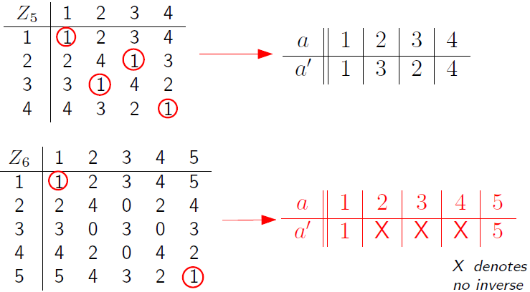
Examples of multiplicative inverse
Verification by scanning through the entire multiplication table. This is not feasible when n is large!

Slide 27
Getting ready for calculating a’ efficiently

Slide 28
Modular Equations to Normal Equations
Namely, a has a multiplicative inverse.
Lemma
The modular equation a ·_{n} x = 1 has a solution in Z_{n} if and only if there exist integers x, y such that ax + ny = 1.
Proof:
a ·_{n} x = r ⬅➔ ax = qn + r, with 0 ≤ r < n. (Euclidian Division Theorem)
a ·_{n} x = 1 ⬅➔ ax = qn + 1 ⬅➔ ax + (−q)n = 1
y = -q

Slide 29
Solution to a ·_{n} x = 1
Corollary:
If a ϵ Z_{n} and x, y are integers such that ax + ny = 1, then the multiplicative inverse of a in Z_{n} is x mod n.
Proof:
n ·_{n} y = 0,
a ·_{n} x = a ·_{n} x +_{n} n ·_{n} y
= (ax + ny) mod n
= 1
How do we find x then?
Extended GCD Algorithm!

Slide 30
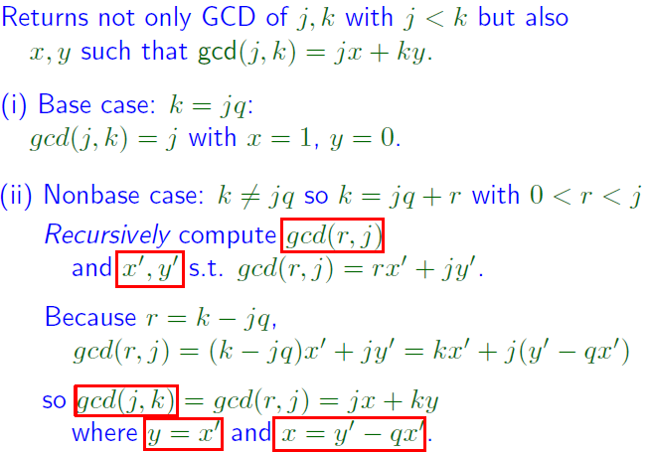
Extended GCD Algorithm

Slide 31
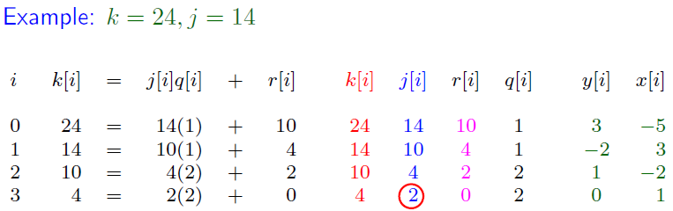
Extended GCD Algorithm – Example
Given two integers j, k, Euclid’s extended GCD algorithm computes gcd(j, k) and two integers x, y such that gcd(j, k) = jx + ky.
Two positive integers j, k have gcd(j, k) = 1 (and thus are relatively prime) if and only if there are integers x, y such that jx + ky = 1.

Slide 32
Computing Inverses
Corollary:
If an element a ϵ Z_{n} has an inverse, we can compute it by running Euclid’s extended GCD algorithm to determine integers x, y such that ax+ny = 1. The inverse of a ϵ Z_{n} is x mod n.
Example:
Given a = 27, n = 58 we can use the Extended GCD algorithm to find that
27(−15) + 58(7) = 1.
Thus the multiplicative inverse of 27 in Z₅₈ is
−15 mod 58
= (−15 + 58) mod 58 = 43.
Reality check: 27 · 43 = 1161 = 20 · 58 + 1

Slide 33
RSA Public-Key Algorithm

Slide 34
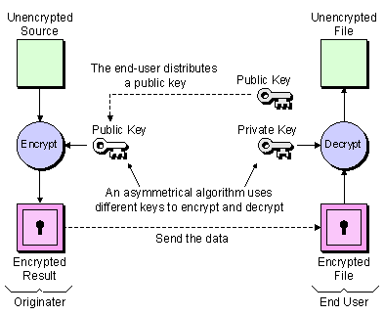
Overview
Also called asymmetric crypto!
Two keys:
public key
private key
Encryption:
public key
Decryption:
private key
Encryption needs to be a one-way function, even if the encryption method is known!

Slide 35
One-to-one function (mapping)
Let p be a prime number. For any nonzero number a ϵ Z_{p}, the function f_{a}(x) = x ·_{p} a is 1-to-1. In particular, the numbers, 1 ·_{p} a, 2 ·_{p} a, . . . , (p − 1) ·_{p} a , are a permutation of the set {1, 2, . . . , p − 1}.
One-to-one function ➔ Its inverse function must exist!

Slide 36
One way function
Given a one-to-one function f(x) = y, easy to calculate y given x but not vice versa.
f(m) = m^{e} mod n is a one-way function
For public-key cryptography, the public encoding function needs to be one-way. The secret decoding function is actually an efficient way of calculating the inverse of encryption function.
This efficient way is only available to the “owner” who constructed the encryption function.

Slide 37
Exponentiation mod n – Basis of RSA

Slide 38
The Rules of Exponentiation

Slide 39
Fermat’s Little Theorem – Intro Example
Theorem:
Let p be a prime number. Then, for every nonzero a ϵ Z_{p}
a^{p−1} mod p = 1.

Slide 40
Fermat’s Little Theorem – Proof
1·_{p} a, 2·_{p} a, . . . , (p−1)·_{p}a
permutation of 1, 2, . . . , p−1
1 ·_{p} 2 ·_{p} · · · ·_{p} (p − 1)
= (1 ·_{p} a) ·_{p} (2 ·_{p} a) ·_{p} · · · ·_{p} ((p − 1) ·_{p}a)
= [1 ·_{p} 2 ·_{p} · · · ·_{p} (p − 1)] ·_{p} (a^{p−1} _{mod} p) .
(a^{p−1} _{mod} p) = 1
Actually, a can be any positive integer that is not a multiple of p.

Slide 41
Corollary
Let p be a prime number. Let m be a nonnegative integer. Then, for every positive integer a that is not a multiple of p,
Example: a = 5,
p = 7, m = 15
a¹⁵ mod 7 = a^{(2·6+3)} mod 7 = a³ mod 7 = 6

Slide 42
The RSA Cryptosystem

Slide 43
The RSA Cryptosystem

Slide 44
Why RSA Work?
If p and q are both prime numbers and both divide z then pq divides z.

Slide 45
Why is RSA Secure?
Someone (adversary) who knows the public information n, e and m^{e} mod n can not figure out m.
Function f(m) = m^{e} mod n is a one-way function.
At present, nobody knows a quick scheme for computing e^{th} roots mod n, for an arbitrary n.
Factor n to find p, q s.t. n = pq ?
No!!. Nobody knows how to factor quickly!
If you could figure out a quick factoring scheme, you could break most modern computer security.
Note: Although nobody knows how to factor quickly we don’t have any proof that factoring must be slow. It’s possible that there’s a fast factorization algorithm out there that no one has found yet . . . .

Slide 46
RSA Example

